Slide 1

WHATSUPP?
INVESTOR PREVIEW · CONFIDENTIAL
Intel on sports supplements?
You deserve better.
George doesn’t just answer supplement questions — he solves them. Powered by the scientists who write the research, George gives every athlete personalised, expert-level guidance that no LLM can match. Sign up today.
WHATSUPP BY GEORGE

Slide 2

THE 3AM CALL from Budapest World Athletics Championships
“I’m on the starting line of the 20 km road race. An electrical storm just hit and they’ve postponed the event for 2 hours
I’ve already eaten my pre-race carbs, hyperhydrated with sodium, and taken my practised doses of caffeine and bicarbonate supplements.
Now what do I do?”
Peaks and half-life of supplements?
Top up doses?
Gut issues with total doses?
Interactions between all the products?
WHATSUPP?
2

Slide 3
Meeting athletes where they’re at
THE OPPORTUNITY
$80B
80-90%
40-70%
Projected global sports nutrition market 2032
Athletes use sports foods/ performance supplements
Athletes consult the internet for supplement advice
runsignup annual trends report January 2023 2023
Garthe and Maughan, 2018
Broniecka et all., 2025
Year on year increases in sports participation and performance nutrition interest demands a credible information source
WHATSUPP?
2

Slide 4
THE ECOSYSTEM
Everybody wants something
SUPPLEMENT INDUSTRY
SPORTING ORGANISATIONS
SPORTS SCIENTISTS/ PRACTITIONERS
ATHLETES AND COACHES
Reassurance that our new position on supplements is correct
Personalised advice that works
Credibility that drives our bottom line
Staying relevant and staying abreast
We need to be in this space but we just don’t have the time to
stay on top of the scientific literature on sports supplements
We want to be First to market with credible products
We want access to research opportunities that show our products work
We’ve finally agreed that sports foods/supplements have value, but we need to be sure that products are safe, effective and free from banned substances
Even if it’s marginal gains, it matters for our performance
We need advice that recognises the nuance and context of what makes us special
We need help to recognise what works
Many studies are poorly done – we need ways to do them better and to connect with colleagues who are experts
5
WHATSUPP?

Slide 5
Where do athletes get their supplement intel?
Area of
Need
Usually cautious,
focused on evidence base
Information
Quality
Well-meaning
anecdata
SCIENTISTS,
DOCTORS, DIETITIANS
OTHER
ATHLETES
AND
COACHES
Number of Athletes Reached
Scientific
literature
Often misinformation,
Spreads dangerously quickly
Typically low quality, and not relevant to sports complexity
Supplement
industry
Social Media
Influencers
Bottom line = profit

Slide 6
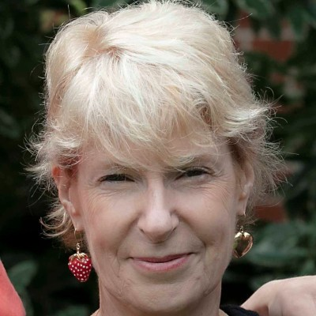
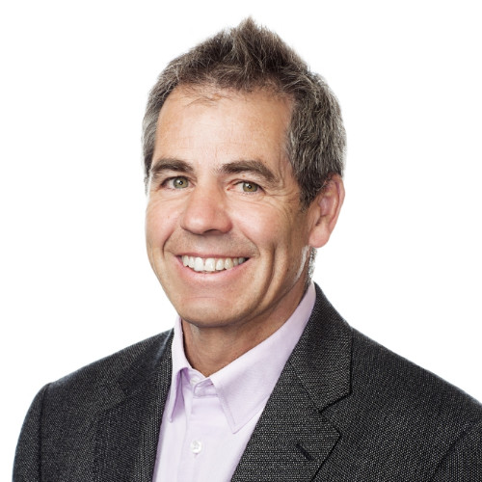

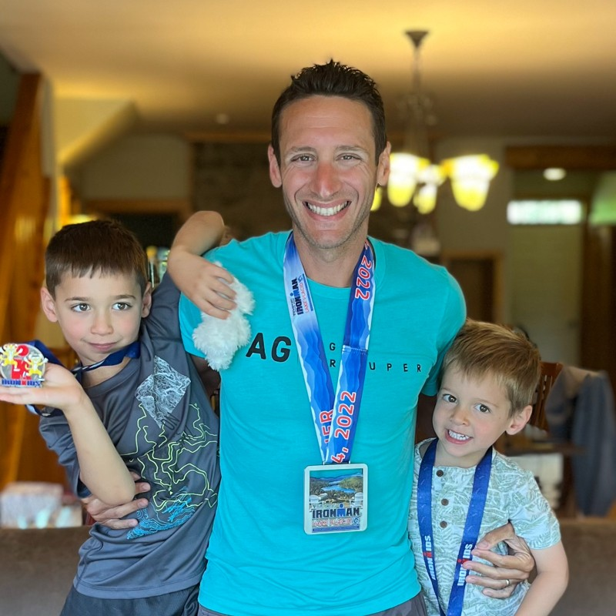

Why are we the ones to deliver this project?
Prof Louise Burke Prof John Hawley Prof David Martin Matt Schuster Dr Eric Zaltas
https://www.linkedin.com/in/louise-burke-61923411/
https://www.linkedin.com/in/john-hawley-aa3b3388/
https://www.linkedin.com/in/david-t-martin-9794994/
https://www.linkedin.com/in/matthew-schuster-b275032/
https://www.linkedin.com/in/eric-zaltas/
>200 years as thought leaders and contributors to elite sport
>1000 scientific publications
>60 years experience in R&D and marketing of nutrition and sports nutrition products
>50 years experience in corporate health and well being
Credibility
Expertise and experience
Insight and innovation
Connections to high performance sport around the world
Capacity to capture and motivate The Wise Crowd
WHATSUPP?

Slide 7
WHY LLMs CAN’T SOLVE THIS
ChatGPT, Gemini, Perplexity — brilliant at averages.
Athletes aren’t averages. They’re edge cases.
01
LLMs generate probable answers, not correct ones
Probabilistic token generation averages population data. A 52-year-old female marathoner racing in the heat is not a population average — she’s a unique case that demands unique expertise.
02
LLMs read research. Experts interpret it.
Supplement studies exist. Many are poor. Only a world-class sports dietitian knows how to synthesise them with clinical judgment, peer knowledge, and athlete context to make an elegant, safe recommendation.
03
LLMs can’t learn from you. George can.
Every interaction with George refines his model of you. Your feedback, your trial data, your race outcomes — George gets smarter with every conversation, building a picture no generic AI ever could.
WHATSUPP?

Slide 8
MEET GEORGE
Your personal sports nutrition expert — available 24/7, powered by the world’s best scientists.
George isn’t a chatbot. He’s an AI sports dietitian trained on the knowledge of the scientists who write the research papers every other AI merely reads. George converses like a world-class expert, personalises every recommendation, and gets smarter the more you interact with him. No edge case is too hard. No athlete profile is too unusual.
EXPERT AI CONVERSATION
PERSONALISED RECOMMENDATIONS
ADAPTIVE LEARNING
George engages like a world-class sports dietitian
Best supplement + best way to use it, for you
George gets smarter every time you interact
Ask George anything — race fueling, supplement timing, heat adaptation, body composition. He responds with personalised, expert-level guidance backed by the scientists who produce the research.
George doesn’t just name a supplement — he tells you exactly how to dose it, when to take it, and how to adapt it to your conditions. Edge cases welcome. Library of ~25 supplements at launch.
Every feedback loop, trial result, and conversation refines George’s model of you. The system learns from each athlete interaction, compounding personalisation across the entire platform.
GEORGE · by PROVEN
5

Slide 9
THE WHATSUPP? DIFFERENCE
Powered by the scientists who do the research — not just the papers they publish.
Other AI systems read what experts publish. George is powered by the experts themselves. No edge case too hard. No athlete too unusual.
What George does differently
Why this is now possible
Engages you like a world-class sports dietitian — not a search engine.
Expert network
The scientists who produced the research fuel George’s intelligence
Personalises supplement recommendations to your age, sex, event, environment, and history.
Adaptive AI
George learns from every athlete interaction, sharpening personalisation at scale.
Gets smarter with every interaction — learning from your feedback, your data, and your outcomes.
Wearables & apps
Garmin, Whoop, TrainingPeaks give George real performance context — not self-reported guesses.
Connects with a wise crowd and harnesses the crowd wisdom
N=1 testing
Blinded crossover trials run in the background, giving George verified personal response data — not population averages.
WHATSUPP?
4

Slide 10
HOW WHATSUPP? WORKS
Tell George about yourself. Get expert guidance.
1
2
SHARE
ASK
You don’t need a better prompt.... You need better access to evidence based insights provided by experts.
Tell George your athlete profile
George delivers your personalised expert recommendation
George wants to know you not a generic athlete. Age, sex, event, conditions, training history, goals, past experiences with supplements.
George draws on expert scientific knowledge to recommend the best supplement and precisely how to use it — tailored to your event, your body, your conditions. No edge case is off-limits.
WHATSUPP?

Slide 11
HOW WHATSUPP? WORKS
While you are improving, so does George
3
4
5
IMPROVE
N = 1
AGGREGATE
Provide feedback — George learns and refines
Be a study of you!
Learn from your people
Tell George how the recommendation worked. Every interaction — every result, every reaction — makes George’s model of you sharper. The system gets smarter with every athlete on the platform.
George can make you a test schedule to systematically investigate how you and your performance react to supplement trials. Connect your gadgets to seamlessly and continuously learn from your data and experiences
Let your anonymized experiences improve the community knowledge. Although you remain an individual, benefit from the richness of collective knowledge
WHATSUPP?
6

Slide 12
HOW WHATSUPP? WORKS
George is the future
6
7
8
EXTEND
ENGAGE THE WISE CROWD
THINK
FORWARD
Expertise adds an extra layer
Collective wisdom is special
THE FUTURE OF WHATSUPP?
Literature and studies take you to a point. Find real gold in the expertise and insights from the best scientists who conduct them. Let George pick their brains about your special needs
Crowd sourced information is not intrinsically smart. But George has a knack of getting supplement experts together to tackle the really intriguing questions and providing wise answers. It’s worth it!
George has plans. Plans to connect you with batch tested versions of the supplements and sports foods you want to use. Plans to be the conduit for ambitious research projects based on citizen sports science. Plans to let supplement manufacturers know what they should be making. Make George part of your better future self.
WHATSUPP?
6

Slide 13
WHY NOW
Five forces converged to make George possible — and necessary.
01
02
03
04
05
Supplements and sports foods became credible
Premium nutrition has a price tag that’s worth it
Disillusionment with the one-dimensional LLMs
The ubiquity of wearables
Expert networks are now connectable
Sporting organisations finally recognised that they play a role in sports nutrition. One that athletes and coaches are interested in. Science decided to meet athletes where they’re at, and to build a credible way to work with them
Maurten, AG1, LMNT, Precision Fuel proved athletes will pay $50–200/mo for evidence-positioned products.
Athletes tried ChatGPT for nutrition advice. They got population averages. They want personalised expertise. George is the answer they were promised.
.
The world’s top sports scientists are accessible as an intelligence layer. George is the first product to harness that expertise at scale.
Garmin Connect crossed 50M users. Strava +25%/yr. Zwift normalized standardized indoor efforts. Now athletes can collect careful data and learn from it
GEORGE · by PROVEN
14

Slide 14
SCIENCE PANEL
Chaired by the most cited sports-nutrition scientist alive.
Every protocol, every statistical decision, every athlete-facing claim passes through this panel.
LB
CHAIR
DM
JAH
Prof. Louise Burke AO
Former Head of Sports Nutrition, Australian Institute of Sport. Chief dietitian for five Australian Olympic teams. Author of the foundational textbook in the field. ~600 peer-reviewed publications.
12

Slide 15
Persy – delayed race
Demonstrates interaction plus
ChatGPT inferiority
Watch it improve.

Slide 16
Mia – background + example of interactive feedback vs
Information dump

Slide 17
Matt – triathlete
N = 1 options

Slide 18
Persy – offer the wisdom of the crowd in the aftermath
Offer options of speaking to an expert/AI version of an expert
Offer options of speaking with a crowd (delayed answers)
Compare with Claude who says he doesn’t do Crowd

Slide 19
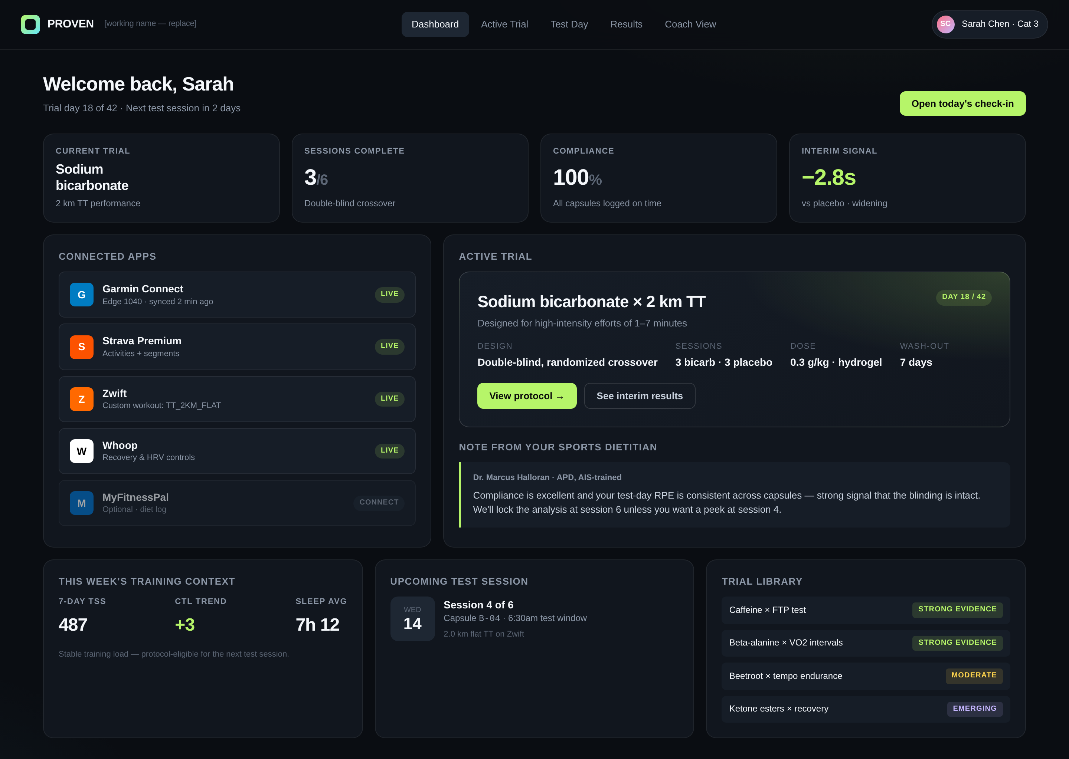
DEMO · 1 OF 4
The athlete dashboard
Sarah, 52, is preparing for a marathon in the heat. George has already recommended her caffeine protocol. Now she’s 18 days into her personalised N-of-1 trial — everything lives on one screen.
Apps she already uses
Garmin, Strava, Zwift, Whoop pre-connected. No new device, no extra workouts.
A trial in flight
Double-blind crossover, 3 bicarb / 3 placebo sessions, hydrogel capsules to keep blinding intact.
George in the loop
George monitors Sarah’s interactions and trial data, refining her supplement recommendations as her race approaches and conditions change.
GEORGE · by PROVEN
7

Slide 20
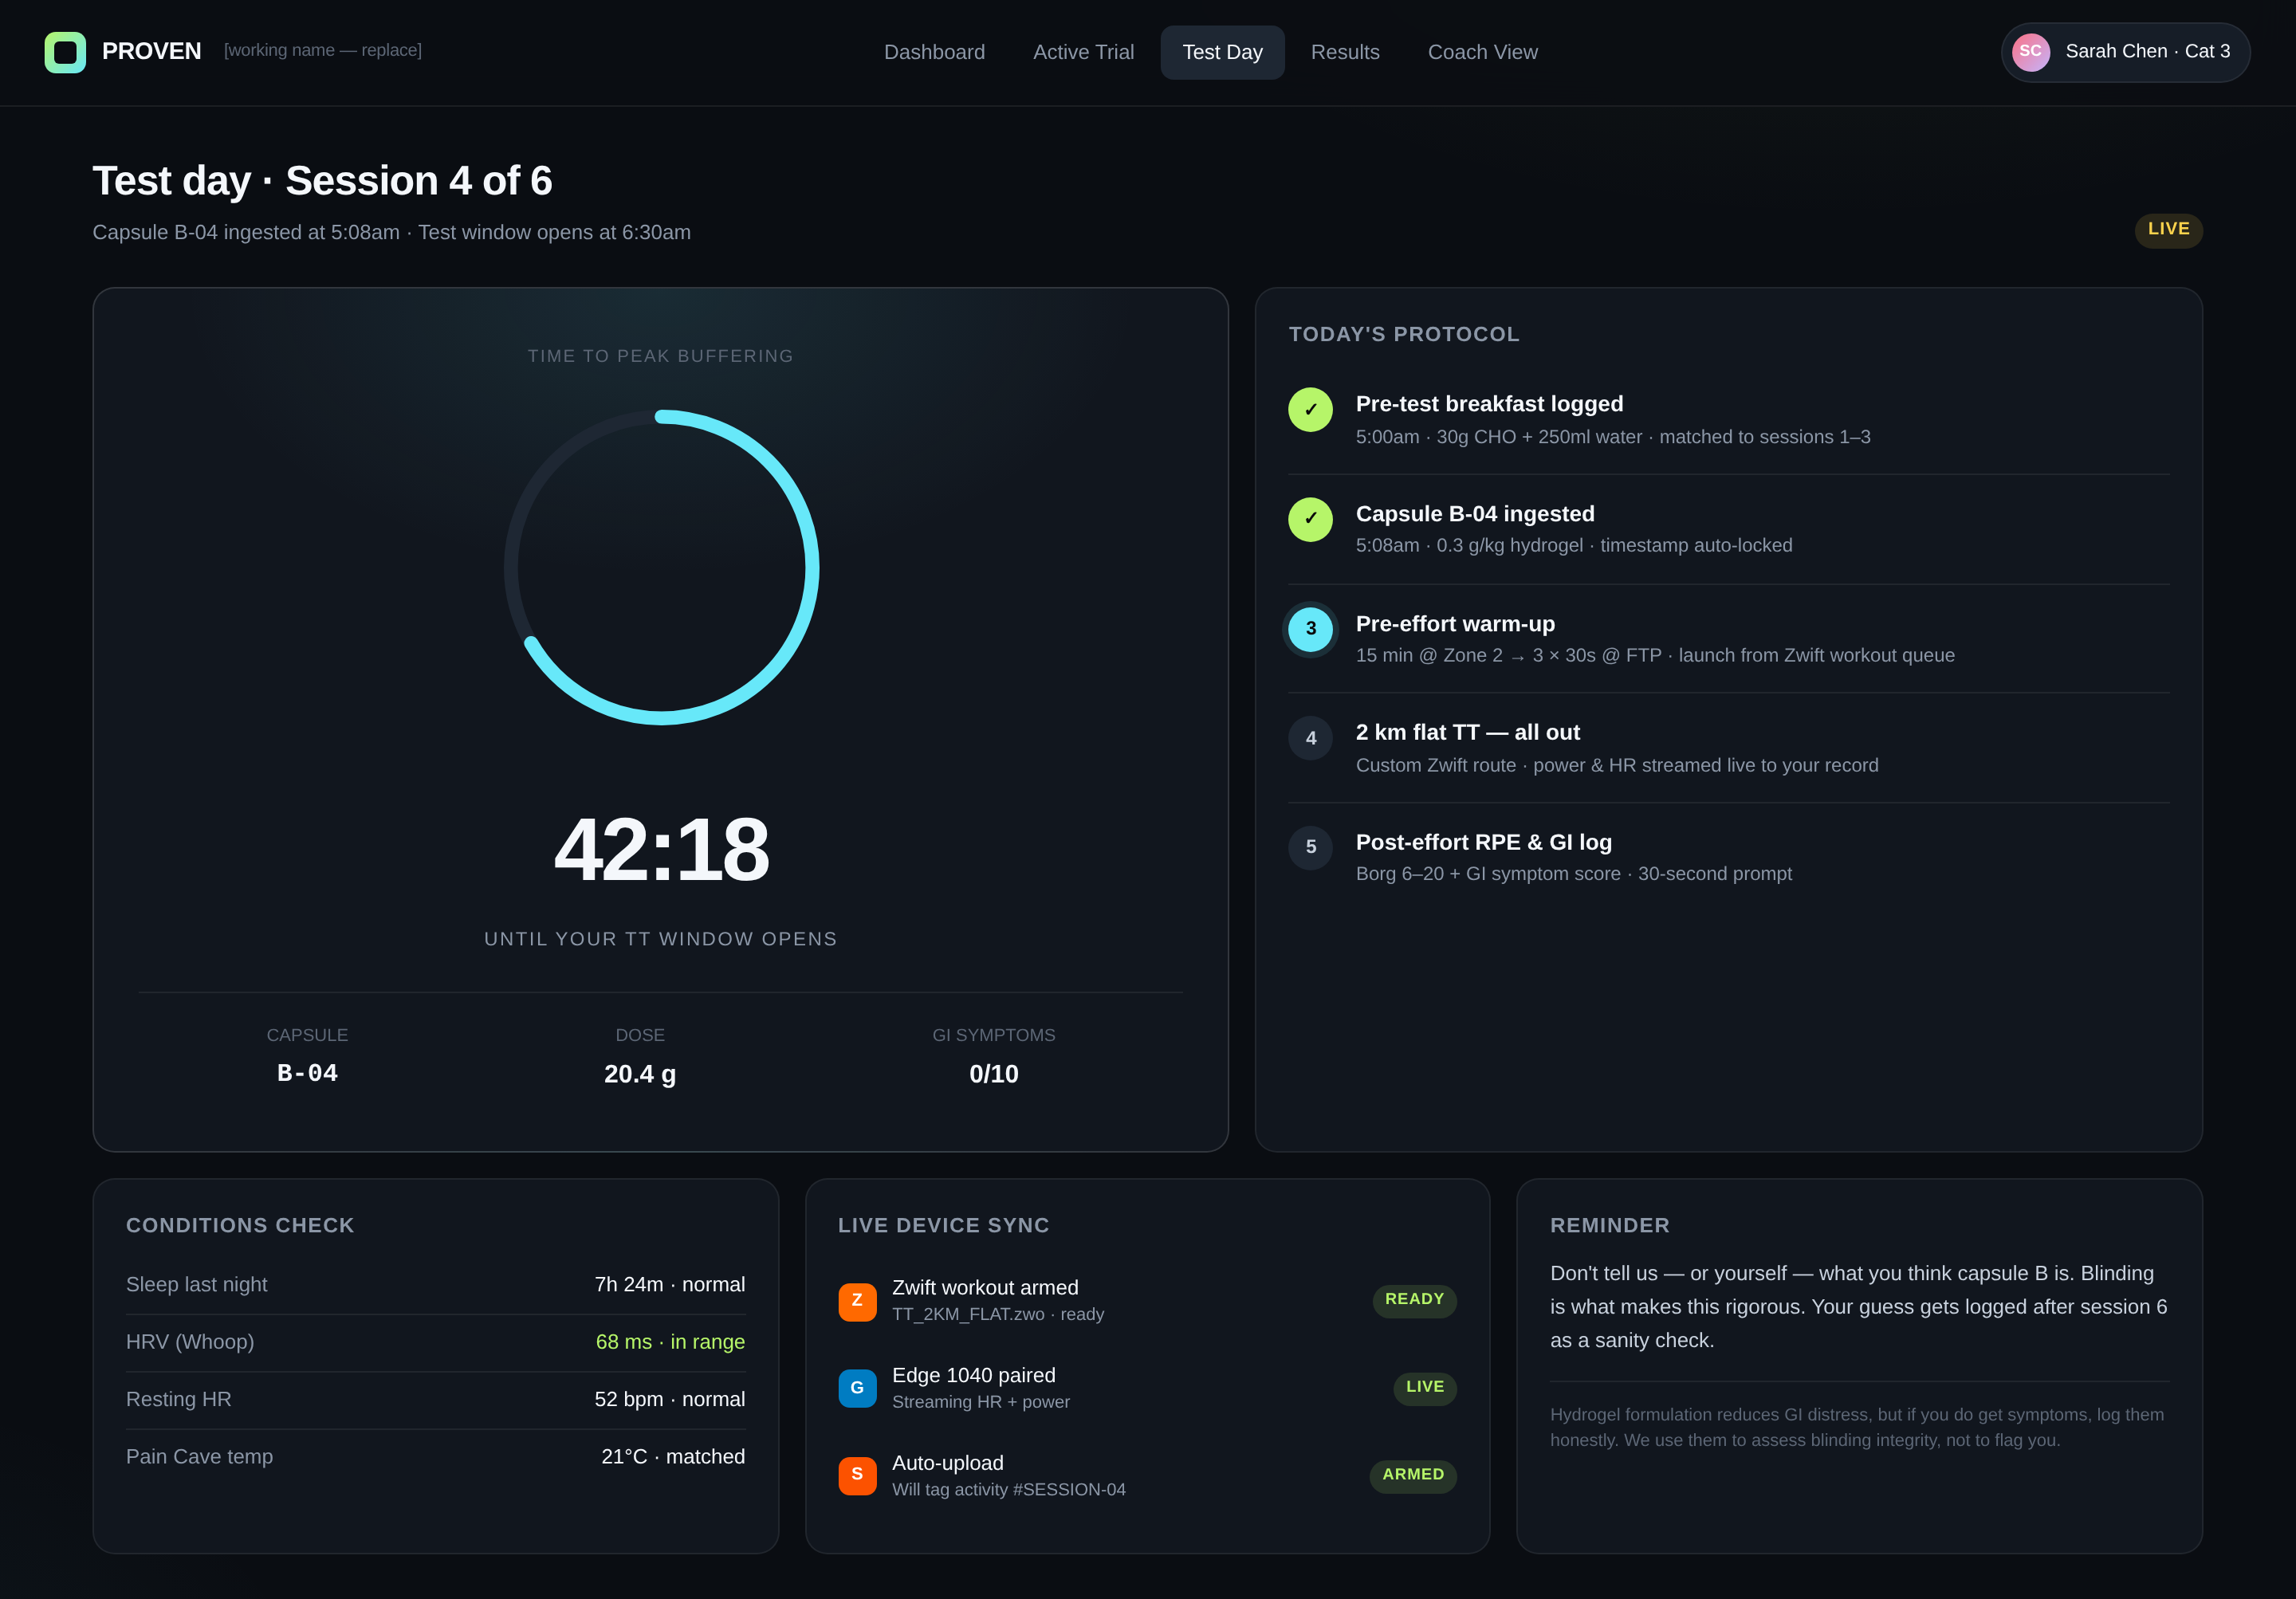
DEMO · 2 OF 4
Test day — the rigor moment
Capsule code, ingestion timestamp, conditions match, device sync — all locked before she pushes a watt.
Standardized every time
Same pre-effort meal, same warm-up, same Zwift workout file. Blinding holds.
Live device telemetry
Power and HR stream from her Edge to her record. Activity auto-tags as Session 4.
Honest about the hard part
GI symptom score logged every time. Tells us if blinding is broken — and protects her data.
GEORGE · by PROVEN
8

Slide 21
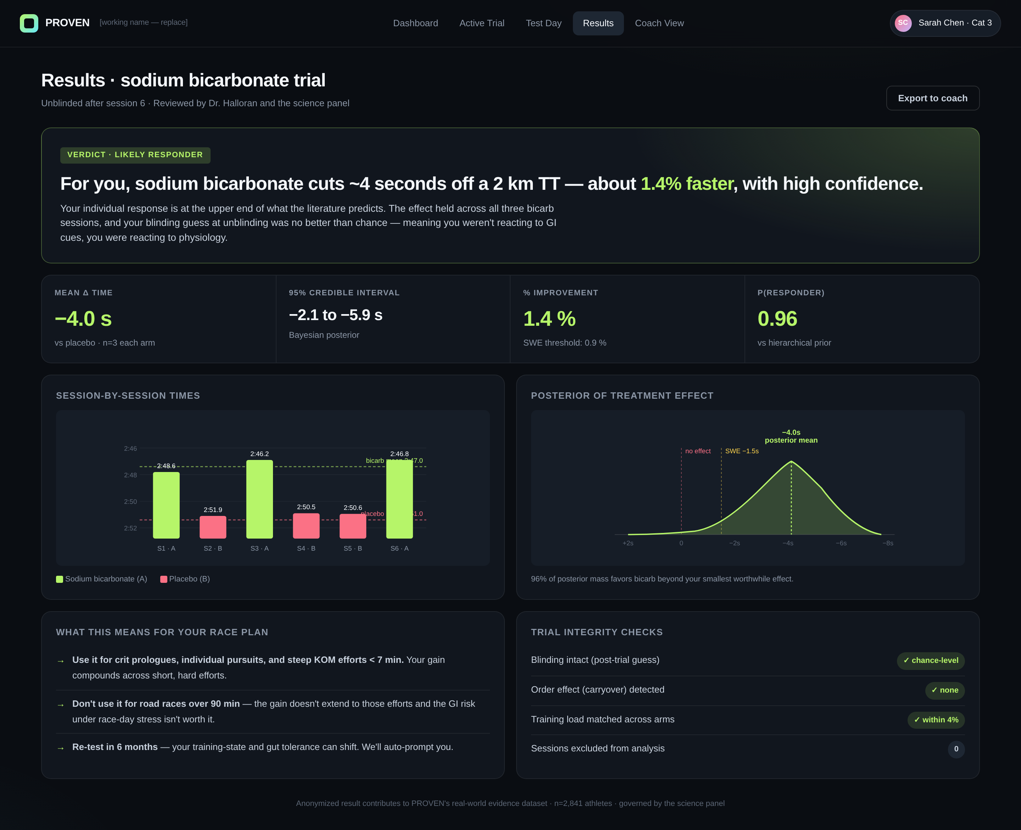
DEMO · 3 OF 4
The personal verdict
After 6 sessions, Sarah doesn't get a meta-analysis. She gets her own answer.
A number she can act on
Bicarbonate cuts ~4 seconds off her 2 km TT — 1.4% faster, with a tight credible interval.
A verdict, not a chart
"Likely responder" with the integrity checks that earned the call: blinding, balance, carryover.
Translated to her racing
Use it for crit prologues. Skip it for road races > 90 min. Re-test in 6 months.
GEORGE · by PROVEN
9

Slide 22
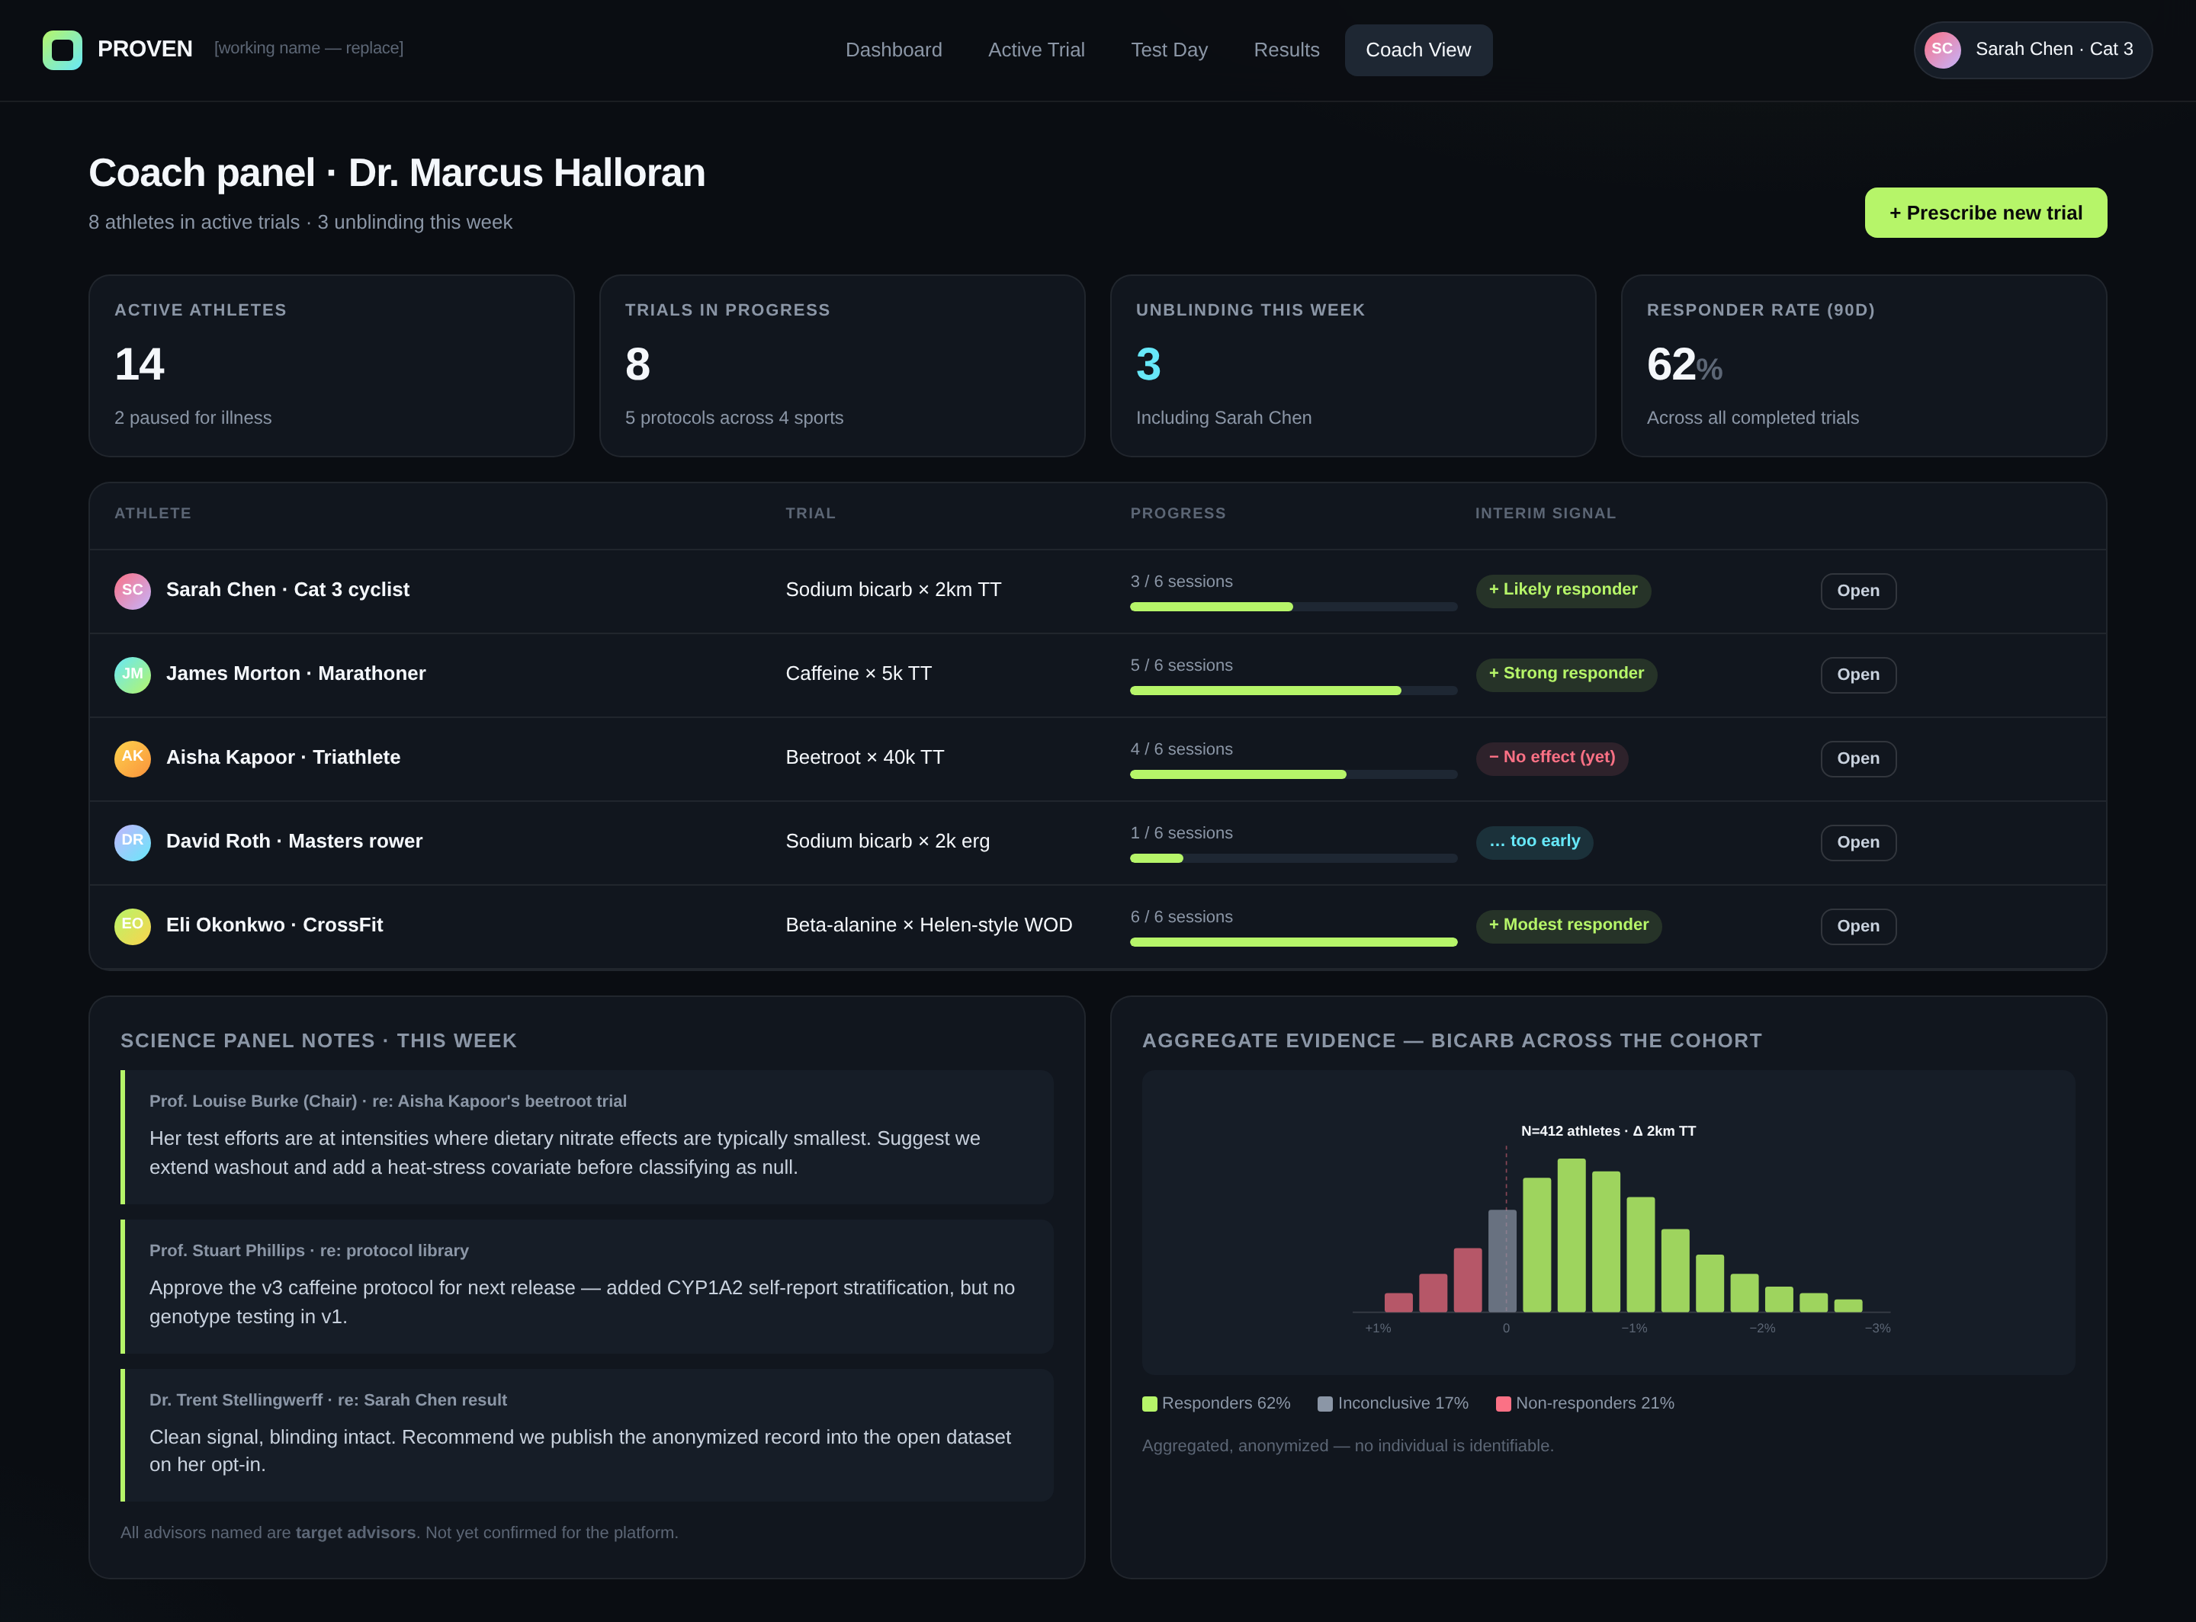
DEMO · 4 OF 4
George + the network effect
Every athlete interaction — opted-in and anonymised — makes George smarter for the next athlete.
A workbench for the dietitian
All their athletes' active trials in one panel. Adjust protocols. Read the science panel's notes.
A real-world evidence engine
Aggregated bicarb data across hundreds of athletes — responder distributions, not just averages.
Defensible compounding moat
George compounds in intelligence — and defensibility — with every athlete who joins the platform.
GEORGE · by PROVEN
10

Slide 23
METHODOLOGY
Built like a clinical trial. Felt like an app.
Every protocol on the platform passes the same six checks. The science panel signs off on each one.
Pre-registered design
Double-blind crossover
Endpoint, dose, washout, exclusion criteria locked before session 1.
Numbered, identical-looking capsules. Sequence locked in a sealed record.
Powered for individual decisions
Hierarchical Bayesian inference
N of sessions chosen for each athlete's session-to-session variability.
Personal effect estimate borrows strength from the cohort prior, with credible intervals.
Blinding integrity checks
Pre-set exit criteria
Post-trial guess + GI symptom log scored for blinding fidelity.
Illness, training-load spikes, or athlete request automatically pause the trial.
GEORGE · by PROVEN
11

Slide 24
SCIENCE PANEL
Chaired by the most cited sports-nutrition scientist alive.
Every protocol, every statistical decision, every athlete-facing claim passes through this panel.
LB
AJ
Prof. Asker Jeukendrup
SP
Prof. Stuart Phillips
CHAIR
Prof. Louise Burke AO
Carbohydrate metabolism · ex-Gatorade Sports Science
Protein & muscle physiology · McMaster University
Former Head of Sports Nutrition, Australian Institute of Sport. Chief dietitian for five Australian Olympic teams. Author of the foundational textbook in the field. ~600 peer-reviewed publications.
TS
Dr. Trent Stellingwerff
KE
Prof. Kirsty Elliott-Sale
Periodised nutrition · Canadian Sport Inst. Pacific
Target advisors — outreach in progress. Not yet confirmed for the platform.
GEORGE · by PROVEN
12

Slide 25
BUSINESS MODEL
Three revenue streams. The third is the moat.
STREAM 1
STREAM 2
STREAM 3
Athlete subscription
Industry-funded trials
Real-world evidence dataset
Counseling tier · $99/mo — async + monthly 1:1
Performance tier · $249/mo — adds N-of-1 trials, capsules included
Elite tier · custom — for pro teams & federations
Premium supplement brands fund N-of-1 cohorts on their products
Athletes opt in, get the trial free, retain individual results
Brand gets credible distributed evidence — not pay-to-play
Anonymized, governance-board-controlled access
Sold into pharma sports-medicine, federations, elite teams
Compounds in value with every trial run on the platform
Target: 6,000 paid athletes by month 24
Maurten, Precision Fuel, Beam, Momentous as launch targets
Defensible flywheel — data quality grows with cohort
GEORGE · by PROVEN
13

Slide 26
THE ASK
Sign up today. Meet George.
Gain access to world-class expertise. No edge case too hard. No athlete profile too unusual.
RAISE
USE OF FUNDS
$ X M
__%
Platform engineering — connector layer, trial engine, coach console
__%
Science panel + protocol library — Burke + 4 chairs, 25 protocols
__%
Clinical operations — capsule supply, blinding, trial logistics
replace X with raise size
__%
Founding sports-dietitian team — 5 APD/SCAN-credentialed coaches
on a [____] valuation cap, target close [____].
__%
GTM — premium endurance & strength sports, federation partnerships
Eric Zaltas · eric@addralabs.com · [phone]
15

